Slide 1
Texas Community Development Block Grant Program
Special Conditions
Administrator Workshop
Notes:
Today we will discuss the Special Conditions that you may see in the Grant Agreement for your project. For clarity, we are going to sort these Special Conditions in two parts or types.
Pre-Construction Special Conditions or before construction starts.
Project Completion Special Conditions or after construction is finished.
For additional guidance on any of the Special Conditions we discuss today, please see Chapter 4, Grant Agreement Special Conditions, of the Implementation Manual.
This presentation will cover Pre-Construction special conditions.

Slide 2
TxCDBG Program
Special Conditions – Pre-Construction

Slide 3
Pre-Construction
Permit and Approval Certification
VAWA
Temporary Project Signage
Buy America Preference
Projects Involving First-Time Water or Sewer Service Beneficiaries
Projects Involving Model Subdivision Rules/Ordinances (Colonia Fund only)
Colonia Street Lighting Funds
Direct Benefit Guidelines
Financial FMS

Slide 4
Pre-Construction
Permit and Approval Certification
Grant Recipient is responsible for ensuring compliance with all permits, authorizations, or other written approvals required by state or federal regulations.
Examples:
TCEQ
THC
TDLR
TxDOT
Notes:
Permit and Approval Certification
Grant Recipient is responsible for ensuring compliance with all permits, authorizations, or other written approvals required by state or federal regulations.
Examples include:
Texas Commission on Environmental Quality (TCEQ) approval of plans and specifications for water and sewer projects;
Texas Historical Commission (THC) approval for construction in a designated Main Street area;
Texas Department of Licensing and Regulation (TDLR) approval for building construction projects;
Texas Department of Transportation (TxDOT) approval for construction of a bridge project; and
other approvals required by state or federal agencies prior to construction.
Although no standard reporting is required, the Grant Recipient must retain copies of all permits and approvals in the local grant files. When corresponding with other agencies about a Grant Recipient’s TxCDBG project, please be sure to reference the Grant Agreement number.

Slide 5
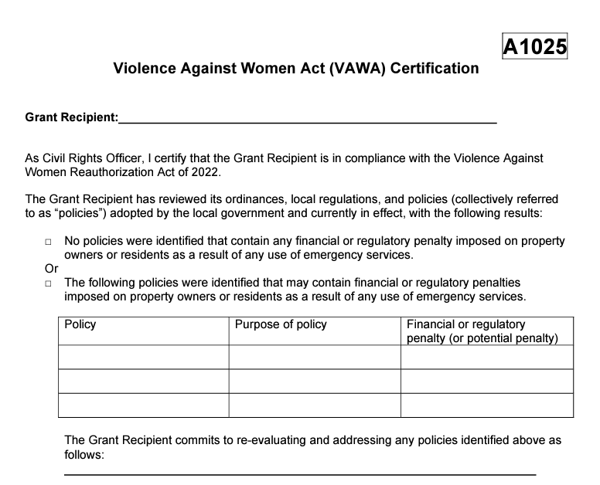
Pre Construction
Violence Against Women Act (VAWA) Certification
VAWA – Form A1025
Notes:
The Violence Against Women Act (VAWA) Reauthorization Act of 2022, which became effective October 1, 2022, includes a new requirement Grant Recipients to support an individual’s, including survivor’s, right to seek law enforcement or emergency assistance.
We will discuss VAWA more in our Group A presentation.

Slide 6
Pre Construction
Buy American Preference
Also known as Buy America Build America Act or (BABA).
Temporary Project Signage
Construction site signage requirements.
Notes:
The Buy American Preference, also know as Buy America Build America Act or BABA, special condition applies to grant recipients that receive funding for infrastructure projects.
Temporary Project Signage – This special condition applies to all construction projects utilizing CDBG funding.
We will dive deeper into both of these special conditions in our Group B presentation.

Slide 7
Pre-Construction
Projects Involving First-Time Water or Sewer Service Beneficiaries
To ensure that projects involving first-time service will serve the anticipated number of beneficiaries, TDA requires that Grant Recipients document the number of first-time service beneficiaries prior to bidding construction.
Notes:
Projects Involving First-Time Water or Sewer Service Beneficiaries
To ensure that projects involving first-time service will serve the anticipated number of beneficiaries, TDA requires that Grant Recipients document the number of first-time service beneficiaries prior to bidding construction.
If fewer than 75% of the beneficiaries proposed in the application intend to connect to the TxCDBG funded infrastructure, the project may not proceed without written approval from TxCDBG.
Prior to bidding construction for a project with first-time service activity, the Grant Recipient must submit to TxCDBG the following:
A list of households that were identified in the original application, including any additional households that will receive first-time service.
NOTE: If the households to receive first-time service were not identified in the application, i.e., using an average household size to calculate beneficiaries, a list of the households identified using the selection guidelines for housing activities should be submitted instead, see Section C Housing Rehabilitation for additional guidance on selection guidelines;
The list must identify the households that have granted temporary construction easements for the project or similar authorization to conduct grant activities on the property;
The list must identify the low-to-moderate income (LMI) status of all households, with TxCDBG Standard Questionnaires for all households retained in local files unless requested by TDA staff; and
The list must be certified via signature or written statement by the chief local official or authorized signatory.
No TxCDBG construction funds will be released until the list has been approved.
NOTE: TxCDBG funded projects that include construction activities on private property are considered to provide direct benefit to homeowners, even if the project does not provide first-time utility service. As such, grant funds may only be expended for this work for households documented as LMI.
EXAMPLE: Yard line replacement made necessary due to a more expansive 03J project that will relocate the collection line is a direct benefit to those households, and grant funds must benefit 100% LMI households.
This Special Condition does NOT require the Grant Recipient to resurvey the households if they were originally surveyed at the time of application. Please contact TDA staff if you have any questions regarding this Special Condition.

Slide 8
Pre-Construction
Projects Involving Model Subdivision Rules/Ordinances (Colonia Fund only)
Certain communities are considered economically distressed areas and are subject to comprehensive platting requirements known as Model Subdivision Rules.
Notes:
Projects Involving Model Subdivision Rules/Ordinances (Colonia Fund only)
Certain communities are considered economically distressed areas and are subject to comprehensive platting requirements known as Model Subdivision Rules.
Communities meet the definition of economically distressed areas if they are:
Unincorporated areas located outside of the corporate limits of municipalities and outside of the extraterritorial jurisdiction of municipalities;
Lacking adequate water or sewer services to meet the minimal needs of residents; and
Eligible for the Texas Water Development Board Economically Distressed Areas Program.
Counties that are awarded grant funds under the Colonia Fund to benefit economically distressed areas are required to document compliance with these requirements, pursuant to Chapter 232 of the Texas Local Government Code. No grant funds may be expended until the Grant Recipient has submitted to TDA a resolution adopting the Model Subdivision Rules, which must contain provisions equivalent to or more stringent than the provisions included in Texas Administrative Code, Title 31, Part 10, Chapter 364, Model Subdivision Rules.
The Grant Recipient may execute the TxCDBG Grant Agreement prior to adoption and enforcement of the Model Subdivision Rules; however, any TxCDBG funds expended before the Grant Recipient follows this requirement will be disallowed and not eligible for reimbursement.

Slide 9
Pre-Construction
Colonia Street Lighting Funds
CDBG funded projects that include street improvements in colonia areas are required by state law to include adequate street lighting in the project.
Notes:
Colonia Street Lighting Funds
TxCDBG-funded projects that include street improvements in colonia areas are required by state law to include adequate street lighting in the project.
Prior to the release of any TxCDBG construction funds, the Grant Recipient must submit a written determination of whether street lighting is adequate for the TxCDBG funded target area.
If current street lighting in the target area is determined to be absent or inadequate, the written determination must include an engineer’s cost estimate, bid tabulation, or other documentation to demonstrate that between 5% and 15% of the TxCDBG grant funds allocated for street improvements are designated for street lighting. Texas Government Code, §487.354

Slide 10
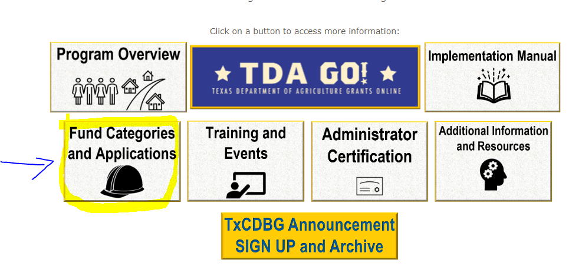
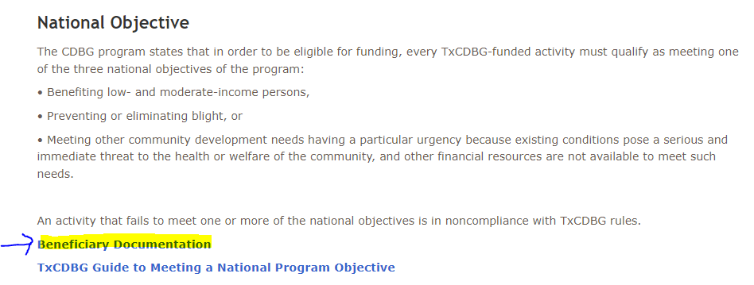
Pre Construction
Direct Benefit Guidelines
https://texasagriculture.gov/Grants-Services/Grants-and-Services/-TxCDBG-Rural-Community-Development-Block-Grant/Fund-Categories-and-Applications
Notes:
Direct Benefit Guidelines Special Condition
Information on determining if a project provides a “direct benefit” may be found in the TxCDBG Guide to Meeting a National Program Objective, located on the TDA website.
TxCDBG funded projects that provide direct benefit to homeowners selected through an application process must receive the following:
TDA approval for the proposed program guidelines prior to the selection of program recipients;
TDA’s release of funds for such activities. Applicable projects are those that provide housing rehabilitation, first-time on-site sewage facilities, replacement of on-site sewage facilities, or scattered first-time water or sewer service yard lines (that are not associated with the installation of a main trunk line).
As appropriate, the following documents must be submitted and approved by TDA prior to the release of any TxCDBG construction funds for direct benefit activities:
Sample Housing Rehabilitation Guidelines (Form C2)
Housing Rehabilitation Work Write-ups and Cost Estimate Worksheet (Form C3)
On Site Sewer Facilities (OSSF) – Sample OSSF Guidelines (Form CII2)
Yard line Assistance Guidelines Template (Form CII2.A).

Slide 11
Pre-Construction
Grant Agreement Specific
Financial FMS/Financial Management
Notes:
Agreement Specific Special Conditions
It is at TDA’s sole discretion that TDA may require programmatic special conditions specific to a project. Such conditions may be incorporated into the original Grant Agreement or amended into the Grant Agreement, as necessary.
An example of this would be Financial FMS/Financial Management. Here is an example of what that might look like. For this project, the grant recipient must provide TDA proof of payment (i.e. paid receipts, canceled checks, wire transfer receipt) for all project related invoices in a format determined by TDA.

Slide 12
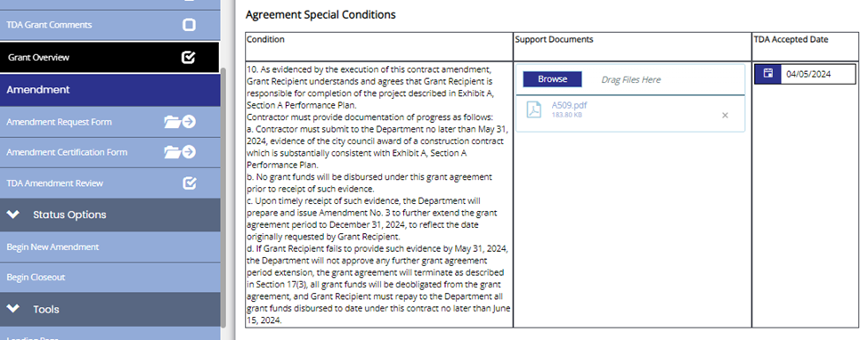
Pre-Construction
Grant Agreement Specific
Amendment Special Condition
Notes:
Another example of a grant specific special condition is a special condition put into the grant agreement via amendment. These may be related to adhering to performance thresholds and/or project timelines.
For this example, the Grant Recipient must provide evidence of a construction award to TDA by a certain date. If the condition is met, the grant term will be extended to the date originally requested by the Grant Recipient. If the condition is not met, the grant project will be terminated.

Slide 13
Questions/Comments
Notes:
This concludes part one of our Special Conditions presentation. Are there any questions or comments?

